Slide 1
CS163: Data structures
Topic: Treap
2026

Slide 2
Today?
Continue Discussing Tree
Examine more advanced trees
2-3 (evaluate what we learned)
B-Trees
AVL
2-3-4
red-black trees
Treap
Group 6

Slide 3
Treap
Treap is a self-balancing randomized binary search tree.
Group 6

Slide 4
Introduction
A randomized binary search tree:
Designed to maintain ordered data
Avoids worst-case O(N) depth of BST
Uses random priorities to stay balanced
Group 6

Slide 5
Introduction
Treap = Binary Search Tree + Heap
Group 6

Slide 6
Treap Properties
Satisfies two distinct properties simultaneously:
Binary Search Tree Property:
left subtree keys < node key
right subtree keys > node key
Heap property (max - heap):
parent priority ≥ children priorities
Group 6

Slide 7
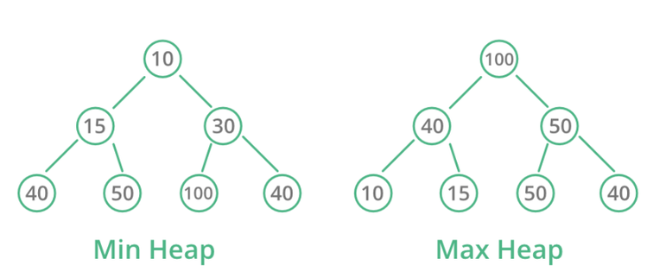
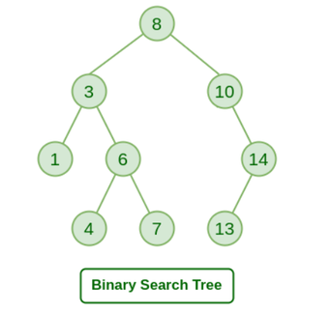

Treap Properties
Binary Search Tree
Heap
Group 6

Slide 8
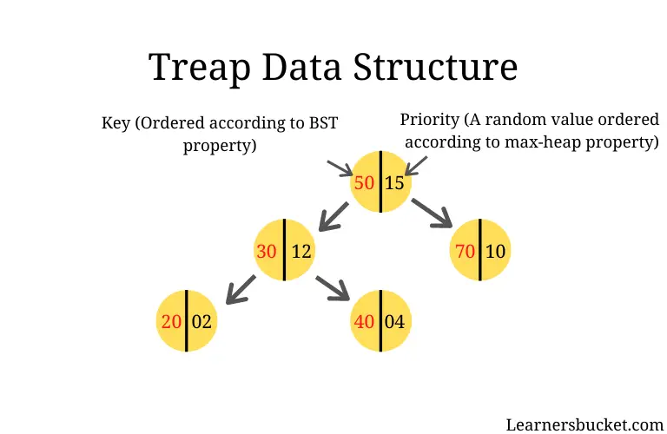
Treap Properties
Group 6

Slide 9
Why Treap?
Each node gets a random priority
Tree shape becomes random
Similar to a random binary tree
Group 6

Slide 10
History of Treap
Proposed by Seidel & Aragon (1989)
Published in Algorithmica (1996)
Later work:
Randomized BST (Martínez & Roura)
Applications in cryptography
Group 6

Slide 11
History of Treap
Connections:
Similar to Quicksort randomness
Based on Cartesian Tree (1980)
Group 6

Slide 12
History of Treap
Quiz: Why is treap also called Cartesian tree?
Group 6

Slide 13
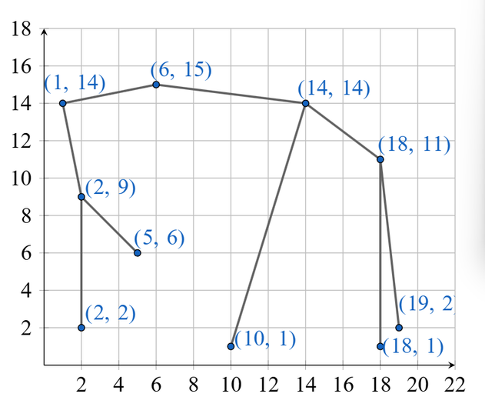
History of Treap
Group 6

Slide 14
Main Data Structures
Stores key + priority
Works like BST + Heap
Group 6

Slide 15
Main Algorithms in Treap
Most treap’s operations are built from split and merge:
Split: Divide tree into 2 parts
Merge: Combine two trees into one
This is a key feature that makes Treap simple and flexible
Group 6

Slide 16
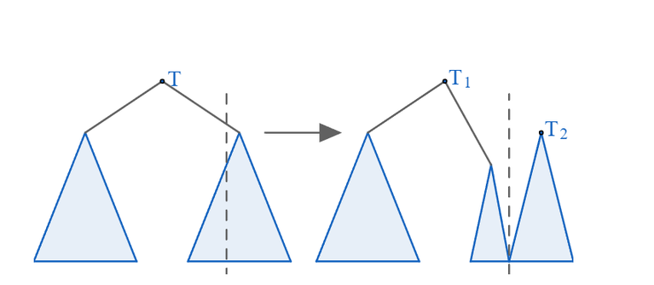
Split Operation
Splits one treap into two valid treaps:
Left treap contains keys ≤ k
Right treap contains keys > k
Group 6

Slide 17
Split Operation
Unlike AVL or Red-Black trees, Treap supports split naturally
This makes many advanced operations much easier
Group 6

Slide 18

Split Operation
Example
Group 6

Slide 19
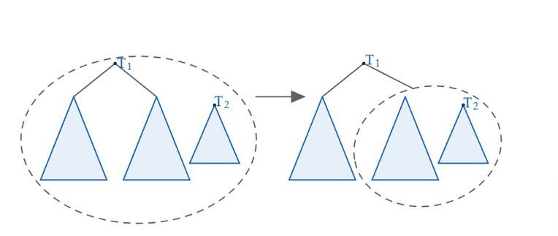
Merge Operation
Combines two treaps into one
Precondition:
Every key in left treap is smaller than every key in right treap
Root is chosen by comparing priorities
Recursively connects the remaining subtrees
Group 6

Slide 20
Merge Operation
Merge is a built-in structural operation of Treap
This is much harder to do directly in AVL or Red-Black trees
Group 6

Slide 21
Merge Operation
Example
Group 6

Slide 22
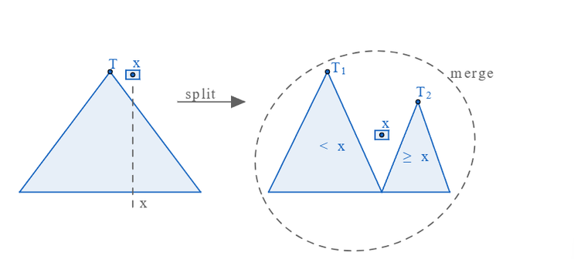
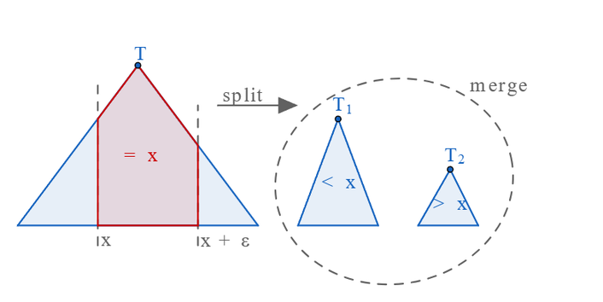
Insert and Erase
Insert: split → add node → merge
Erase: split → remove node → merge
Group 6

Slide 23
Bulk Set Operations
Treap also supports efficient set operations:
Union
Intersection
Difference
Group 6

Slide 24
Bulk Set Operations
Strategy:
choose the root with higher priority
split the other treap by that root key
recursively combine corresponding subtrees
Works efficiently on whole sets, not just single elements
Group 6

Slide 25
Why Treap is Special
Easier to extend for:
Set operations
Range operations
Implicit sequence structures
Simpler and more flexible than many self-balancing trees
Group 6

Slide 26
Why Treap is Special
BST: simple, but may become unbalanced
AVL / Red-Black: balanced, but more complex
Treap: randomized, elegant, and highly flexible
Group 6

Slide 27
Implementing Treap
Treap Node:
struct Node{
int val;
int pri;
Node *left, *right;
Node(int k){
val = k;
pri = rng();
left = right = nullptr;
}
};
Group 6

Slide 28
Implementing Treap
Random Number?
Group 6

Slide 29
Implementing Treap
Some built-in random number generators:
C++:
#include <random>
rand()
mt19937
Python:
import random
randint()
...
Group 6

Slide 30
Implementing Treap
Splitting
Group 6

Slide 31
Implementing Treap
void split(Node* root, int val, Node* &left, Node* &right){
if (root == nullptr){
left = right = nullptr;
return;
}
if (root->val <= val){
split(root->right, val, root->right, right);
left = root;
} else{
split(root->left, val, left, root->left);
right = root;
}
}
Group 6

Slide 32
Implementing Treap
Merging
Group 6

Slide 33
Implementing Treap
Node* merge(Node* left, Node* right) {
if (left == nullptr || right == nullptr){
return left ? left : right;
}
if (left->pri > right->pri) {
left->right = merge(left->right, right);
return left;
} else {
right->left = merge(left, right->left);
return right;
}
}
Group 6

Slide 34
Implementing Treap
Inserting
Group 6

Slide 35
Implementing Treap
void insert(Node* &root, int val){
Node *left = nullptr;
Node *mid = nullptr;
Node *right = nullptr;
split(root, val, left, right);
split(left, val - 1, left, mid);
if (mid == nullptr){
mid = new Node(val);
}
root = merge(merge(left, mid), right);
}
Group 6

Slide 36
Implementing Treap
Erasing
Group 6

Slide 37
Implementing Treap
void erase(Node* &root, int val){
Node *left = nullptr;
Node *mid = nullptr;
Node *right = nullptr;
split(root, val, left, right);
split(left, val - 1, left, mid);
if (mid != nullptr){
delete mid;
}
root = merge(left, right);
}
Group 6

Slide 38
Complexity?
How about the Complexity?
Isn’t it O(N) splitting and merging?
Group 6

Slide 39
Complexity?
Every node in a Treap contains 2 values:
Key: satisfies the property of a BST
Priority: assigned by a random value and satisfies the property of the Heap.
Group 6

Slide 40
Complexity?
The major issue of a normal BST is that the worst complexity can be up to O(N) if we insert the data in a sorted order.
But in a Treap, by assigning priority randomly, the order of the nodes no longer depends on the order that we input.
Group 6

Slide 41
Complexity?
A BST that created by a random permutation of N element has the expected height is O(logN)
Moreover, by probability and statistics, the average distance between the root to a random node inside the Treap is approximately 2lnN
Group 6

Slide 42
Complexity?
Therefore, the average complexity of the operations (like finding, inserting, erasing,...) is O(logN)
Group 6

Slide 43
Complexity?
Quiz: What is the worst complexity of the Treap?
Group 6

Slide 44
Implicit Treap
In their most basic form, treaps are not really useful, because we have many self-balancing trees that are much more efficient and faster than treaps.
However, with implicit treaps, we can efficiently perform operations on a regular array in fashion similar to segment trees and fenwick trees.
Group 6

Slide 45
Implicit Treap
Some operations can be done by implicit treaps:
Insert an element x at position i
Delete the element at position i
Performing interval queries (sum, min, max, etc.)
Perform interval updates (add, set, reverse, etc.)
Group 6

Slide 46
Implicit Treap
Normal Treap Node:
struct Node{
int val;
int pri;
Node *left, *right;
Node(int k){
val = k;
pri = rng();
left = right = nullptr;
}
};
Group 6

Slide 47
Implicit Treap
Implicit Treap Node
struct Node{
int val;
int pri;
int size;
Node *left, *right;
Node(int k){
val = k;
pri = rng();
size = 1;
left = right = nullptr;
}
};
Group 6

Slide 48
Implicit Treap
Splitting
Group 6

Slide 49
Implicit Treap
void split(Node* root, int k, Node* &left, Node* &right){
if (root == nullptr){
left = right = nullptr;
return;
}
[...]
}
Group 6

Slide 50
Implicit Treap
int idx = nodeSize(root->left);
if (idx < k){
split(root->right, k - idx - 1, root->right, right);
left = root;
} else{
split(root->left, val, left, root->left);
right = root;
}
root->size = 1 + nodeSize(root->left) + nodeSize(root->right);
Group 6

Slide 51
Implicit Treap
Merging is the same with a normal treap.
Group 6

Slide 52
Implicit Treap
A node in a Implicit Treap represents a segment of an array.
Combine with the power of splitting and merging of a Treap, we can cut, paste, and make other operations with the segments of the arrays by using this data structure.
Group 6

Slide 53
Application
Standard Treap:
Ease of implementation: It is easy to implement more than other self-balancing trees.
Ordered set: By storing the size of the subtree at each node, we can find the kth-smallest element in O(logN)
Group 6

Slide 54
Application
Standard Treap:
Joining and Splitting Databases: Treaps can be split into two trees and merged back together in O(logN) time.
Group 6

Slide 55
Application
Implicit Treap:
Dynamic Array with Fast Insert/Delete
Persistent Data Structures: Useful in Undo mechanisms in text editors or version control logic.
Rope Data Structure: used to manage large blocks of text, with efficient cutting, copying, and pasting massive strings.
Group 6

Slide 56
Programming Assignments
Reversals and Sums (CSES 2074)
Given an array of n integers, you have to process following operations:
reverse a subarray
calculate the sum of values in a subarray
Group 6

Slide 57
Programming Assignments
Solution: Implicit Treap
Group 6

Slide 58
Programming Assignments
Each node stores an extra element sum
Group 6

Slide 59
Programming Assignments
Calculate the sum (2nd operation):
Split the treap into 3 parts:
[1, L - 1]
[L, R]
[R + 1, N]
Output the sum of the middle part
Merge
Group 6

Slide 60
Programming Assignments
Reverse a subarray: Lazy propagation
Each node stores an extra flag lazy to check if that segment is reversed or not
Group 6

Slide 61
Programming Assignments
When we reach a node that has its lazy is true, we swap its left and right child node, update the lazy of its children, then we set its lazy to false again.
This process can be solved simply by using XOR (Exclusive OR)
Group 6

Slide 62
Programming Assignments
Reverse a subarray:
Split the treap into 3 parts:
[1, L - 1]
[L, R]
[R + 1, N]
Update the lazy of the middle Node:
mid->lazy ^= 1
Merge
Group 6

Slide 63
Programming Assignments
Substring Reversals (CSES 2073)
Given a string, your task is to process operations where you reverse a substring of the string. What is the final string after all the operations?
Group 6

Slide 64
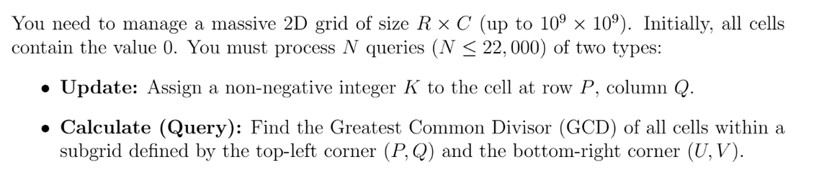
Programming Assignments
Game (IOI 2013)
Group 6

Slide 65
Comparison
Group 6

Slide 66
Benchmark Problem
Substring Reversals (CSES 2073)
Perform many range operations [a, b]
Reverse substring in place
Input size up to 200,000
Group 6

Slide 67
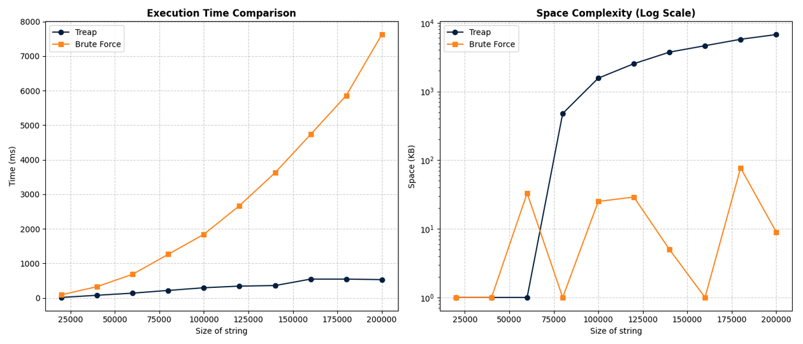
Result:
Group 6

Slide 68
Performance Results
Brute Force:
Time: O(nm) as the string size (n) and operations (m) (reach 7500ms)
Space: Maintains a very low and inconsistent memory footprint (under 100 KB)
Treap:
Time: O(m log n) (reach 600ms)
Space: Reaching nearly 10,000 KB (10 MB).
Group 6

Slide 69
Why Treap Works Better
Supports range operations efficiently
Avoids repeated string copying
Time complexity: O(m log n) vs O(nm)
“Treap transforms the problem into structural operations instead of repeated modifications.”
Group 6

Slide 70
Second Experiment
Insert and retrieve elements
Compare:
BST
Treap
Red-Black Tree
Test on:
random data
sorted data
Group 6

Slide 71
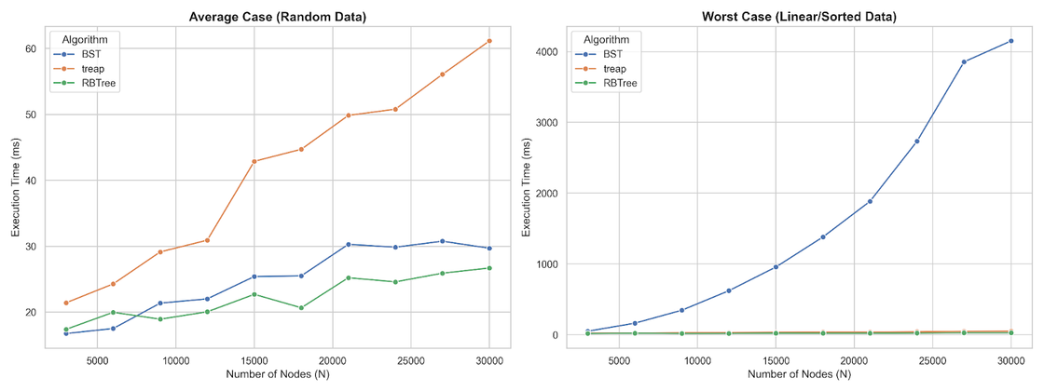
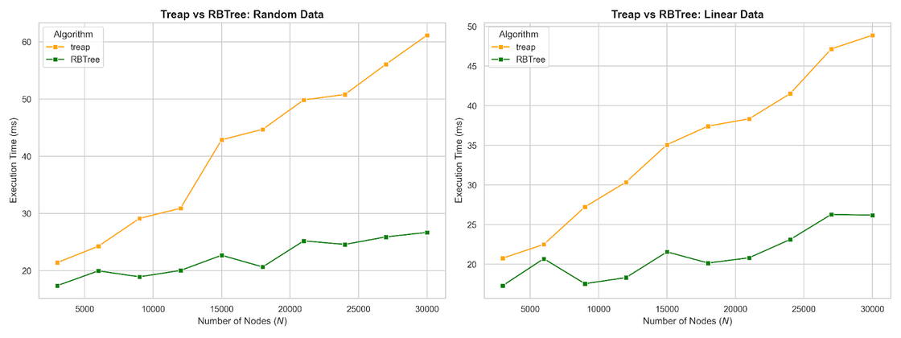

Slide 72
BST Performance
Works well on random data
Fails on sorted input
Becomes O(n) in worst case
highly unreliable
Group 6

Slide 74
Treap Performance
Stable on all inputs
Handles both:
random data
sorted data
Slight overhead:
random priority
balancing operations
consistent performance
Group 6

Slide 76
Red-Black Tree Performance
Fastest in this benchmark
Highly optimized balancing
Very stable
But more complex to implement
Group 6

Slide 78
Treap vs Other Structures
vs BST:
much more reliable
vs Red-Black Tree:
slightly slower
but simpler and more flexible
Group 6

Slide 80
Key Takeaways
Treap is much better than brute force
More reliable than standard BST
Not always the fastest (RBTree wins)
Best for:
range operations
dynamic sequences
flexible problems
Group 6

Slide 81
Why Treap is Important
Combines:
efficiency
flexibility
Supports:
split
merge
range operations
A powerful tool in advanced problems
Group 6

Slide 82
Why Treap is Important
→ May not be the fastest structure, but offers a unique combination of simplicity, flexibility, and strong performance.
Group 6

Slide 83
Quiz 1
Which two core operations are used to build most Treap algorithms?
A. Push and Pop
B. Search and Update
C. Split and Merge
D. Rotate and Recolor
Group 6

Slide 84
Quiz 1
Which two core operations are used to build most Treap algorithms?
Answer:
A. Push and Pop
B. Search and Update
C. Split and Merge
D. Rotate and Recolor
Group 6

Slide 85
Quiz 2
Why does a Treap tend to stay balanced?
A. It performs rotations like AVL trees
B. It enforces strict height constraints
C. It uses random priorities
D. It sorts nodes after insertion
Group 6

Slide 86
Quiz 2
Why does a Treap tend to stay balanced?
Answer:
A. It performs rotations like AVL trees
B. It enforces strict height constraints
C. It uses random priorities
D. It sorts nodes after insertion
Group 6

Slide 87
Quiz 3 — Merge condition
When can two treaps be merged directly?
A. When both have equal size
B. When their priorities are equal
C. When all keys in left < all keys in right
D. When both are balanced
Group 6

Slide 88
Quiz 3 — Merge condition
When can two treaps be merged directly?
Answer:
A. When both have equal size
B. When their priorities are equal
C. When all keys in left < all keys in right
D. When both are balanced
Group 6

Slide 89
Quiz 4
Which statement is TRUE about Treap?
A. Treap always has lower time complexity than Red-Black Tree
B. Treap guarantees perfect balance
C. Treap has expected O(n log n) height
D. Treap does depend on randomness
Group 6

Slide 90
Quiz 4
Which statement is TRUE about Treap?
Answer:
A. Treap always has lower time complexity than Red-Black Tree
B. Treap guarantees perfect balance
C. Treap has expected O(n log n) height
D. Treap does depend on randomness
Group 6

Slide 91
Quiz 5
If we insert sorted data into a Treap, what happens?
A. Tree becomes a chain like BST
B. Tree stays balanced (high probability)
C. Tree becomes a heap
D. It depends only on key values
Group 6

Slide 92
Quiz 5
If we insert sorted data into a Treap, what happens?
Answer:
A. Tree becomes a chain like BST
B. Tree stays balanced (high probability)
C. Tree becomes a heap
D. It depends only on key values
“Treap ignores insertion order thanks to randomness.”
Group 6

Slide 93
Quiz 6
What happens if all priorities in a Treap are equal?
A. Still balanced
B. Becomes a standard BST
C. Becomes a Linked List
D. Program crashes
Group 6

Slide 94
Quiz 6
What happens if all priorities in a Treap are equal?
Answer:
A. Still balanced
B. Becomes a standard BST
C. Becomes a Linked List
D. Program crashes
Group 6

Slide 95
Treap
Thank you for listening
Group 6

